Slide 1

Summary and precis writing
A significant reduction of the original source.

Slide 2
Points to discuss.
Understanding summary and Precis.
Precis development process.
Reading Strategy: The SQ3R Method
4 step method for precis writing.
Strategies for Writing a Summary
Determine the purpose
Develop and State the purpose and thesis using the structure.
Sum-up the body.
4. Tips to consider.

Slide 3
What is a Summary?
There are two types of summarizing:
1) free summarizing, and 2) précis-writing.
“A free summary is:
A condensed version of a broad text I.e. a book or thesis.
A brief paraphrasing of the main idea and relevant details keeping the same tone as the original piece.
It does contain opinions and does not require a formal conclusion.
It is boiled down so that only the essence of the original remains.
One of its varieties is the synopsis, i. e., the summary of a book.

Slide 4
Précis
A Précis:
A shorter version of a source i.e. a paragraph, chap­ter, letter, or a document, but not of a full-length book.
Serves as a shorter substitute for the original text or speech.
It uses the same language-key terms, data, concepts, phrases, order and overall structure of the original source.
For a paragraph, it is the gist or main theme expressed in few sentences.
It should be lucid/clear, concise, complete (all essential points).
It is 1/3 of the original text, "clearly expressed, brief and to the point.“
Make sure you keep the author’s tone and meaning, and use indirect speech.
More rules on page 239.

Slide 5
Précis and summary-difference
The main differences are:
A summary is a short-clear-high pointer, while Precis is a little précised out version of summary.
in a précis, the language-key terms, data, concepts, phrases, order and overall structure of the original source is used.
In paraphrases and summaries, few words from the original source and maximum of the writers own words are used.
In a Précis, use the key terms along with own words.
Précis, gives only the thought of the original text while summary includes personal opinions too.

Slide 6
Reading the text

Slide 7
Understanding a paragraph/text.
Ask three questions about the paragraph:
Who or what is the paragraph about?
What aspects of who or what is the author concerned with?
What does the author really want the readers to know about who or what?

Slide 8
Reading Strategy: The SQ3R Method
Survey, skim, and scan entire reading assignment. Preview titles, subtitles, charts, diagrams, figures, tables, conclusion, and abstract/introduction.
Question the authors’ purpose and tone. Develop and write out questions about each section of the reading, and use them to guide your reading and note-taking.
Read the assignment thoroughly. Read one section at a time, reflect on what you read, and don’t get too bogged down with details. Search for the main ideas and supporting details.
Recite and recall the information by summarizing and paraphrasing. Find the answers to the questions you wrote down earlier.
Review the reading again and over time.

Slide 9
Annotation
ANNOTATE:
Try different note-taking strategies (mapping, outlining, 2-column, word-for-word. It helps avoid going back and re-reading).
•Pay attention to what each section is about. The Abstract, Discussion, and Conclusion sections usually have the most important information.
•Write summary notes for main points, in the margin, or on a separate paper.
•Highlight only very important quotes or terms

Slide 10
Précis development 4 steps?
Step 1 | Step 2 | Step 3 | Step 4
Count words in original | Cross out description | Get a dictionary | Omit interjections (emotions/feelings words)
Read original | Summarize sentences | -check for various meanings | Omit appositives (nouns renaming the noun)
Re-read original | Summarize paragraphs | -check for spelling | Omit emphasis words
Annotate original | Check for overall idea of | “X” all articles | Change metaphor/ & similes
Understand sentences | -each sentence and | “X” all prepositions | Omit rhetorical Questions
Understand paragraph meanings | -each paragraph |  | Write your précis!

Slide 11
Précis development steps?
steps to follow:
Read and reflect on the original text carefully, several times, in order to write a proper précis.
Underline, mark and write down all the main ideas/ imp points of the passage in order they appear- outlining the ideas.
Supply a short title which will express the subject.
Draft a paragraph that reflects these points without adding any new content.
To keep the précis brief, look for places where you can shorten phrases and remove any non-essential language.
For example, Paulo Coelho’s quotation, “It’s part of the human condition to want to share things—thoughts, ideas, opinions,” could become “Humans want to share ideas with others.”

Slide 12
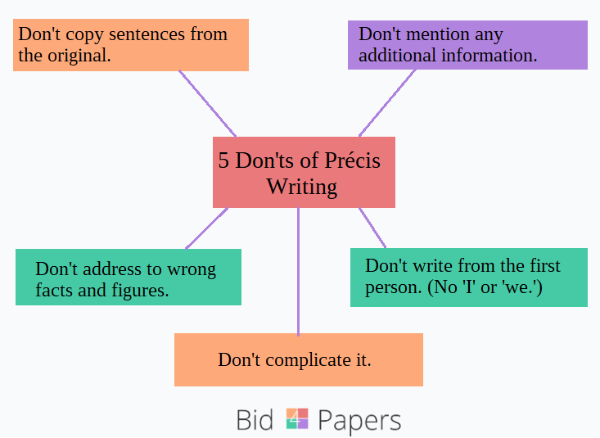

Slide 13
Example of a Précis
Original text:
In the beginning of the twenty-first century, more unrelated people are living together under the same roof. These people may be joined together for love. They may be joined for convenience. Or, they may be joined out of necessity. Whatever the reason, choosing a roommate is one of the most important decisions you will make. If two people are united for love, then choosing a roommate is a very personal decision. If two or more people are going to live together for convenience, or out of necessity, then choosing roommates is an important decision. This decision must be well thought out because choosing the wrong roommate could cost you financially, physically, and mentally. Choosing a roommate is difficult, but the process you use in choosing a roommate is as important as the roommate you choose, because the process you choose will lead to your roommate, and your new roommate will have a significant effect on your life.

Slide 14
Example of a Précis
Original text: underlined main ides and important points.
In the beginning of the twenty-first century, more unrelated people are living together under the same roof. These people may be joined together for love. They may be joined for convenience. Or, they may be joined out of necessity. Whatever the reason, choosing a roommate is one of the most important decisions you will make. If two people are united for love, then choosing a roommate is a very personal decision. If two or more people are going to live together for convenience, or out of necessity, then choosing roommates is an important decision. This decision must be well thought out because choosing the wrong roommate could cost you financially, physically, and mentally. Choosing a roommate is difficult, but the process you use in choosing a roommate is as important as the roommate you choose, because the process you choose will lead to your roommate, and your new roommate will have a significant effect on your life.

Slide 15
Example of a Précis
Précis:
More unrelated people are living together out of love, convenience, or necessity. When choosing a roommate for convenience or necessity, the process must be well thought out because the person you choose will have a significant effect on your life financially, physically, and mentally.

Slide 16
Strategies for Writing a Summary of longer texts

Slide 17
Strategies for Writing a Summary
STEP 1. Determine the author’s Purpose: what does the author want to do with the information, what`s his attitude, what type of reaction desired?
Choose just the right verb or verbs:
Inform? Persuade? Defend? Attack? Justify? Compare? Contrast? Illustrate?
Example: The Declaration of Independence:
Which verbs express the purpose of what founders are doing in the document?
Basically, it has three parts:
First: They assert, pronounce, or hold…
Second: They accuse, indict, or denounce King George…
And finally: They declare, proclaim, or conclude…

Slide 18
Content Verb Reference List
tells explains compares lists shows defines acknowledges
evaluates classifies adds defends asserts features depicts
identifies entertains confirms names considers offers judges
contrasts praises demonstrates provides recommends endorses
asks suggests entices

Slide 19
Strategies for Writing a Summary
STEP 2. State Purpose and Thesis: For purpose understanding the structure of the text and decide on:
At different points in the essay, does the author:
• argue a point?
• present/concede/critique a counterargument?
• compare and/or contrast views?
• offer an alternative?
• examine a cause or effect?
• break a subject down into categories?
• explain a process?

Slide 20
STEP 2. State Purpose and Thesis. Cont.
For example, let’s go back to the Declaration, and say I’ve chosen my three verbs.
In The Declaration of Independence, the Founders
•assert
•accuse
and
•conclude

Slide 21
STEP 2. State Purpose and Thesis. Cont.
For example, let’s go back to the Declaration, and say I’ve chosen my three verbs.
In The Declaration of Independence, the Founders
•Assert that tyrannical governments must be overthrown
•Accuse King George’s government for it`s tyrannical acts
and
•conclude that his government must therefore be overthrown

Slide 22
STEP 2. State Purpose and Thesis. Cont. Now, put it all together =>
In the first sentence of the Summary, state the Purpose and Thesis.
“In ________, ___________ ________ [title] [author] [verb]
(That clause) that _____________________.”
[thesis/main idea in your own words]
“In The Declaration of Independence, the Founders assert that tyrannical governments must be overthrown, accuse King George’s government for it`s tyrannical acts, and conclude that his government must therefore be overthrown.”

Slide 23
Sample thesis.
formula:
Specific name of piece + strong action verb + main idea.
The 60 Minutes story “Thrift Shop Masterpiece” explains the controversy surrounding a possible Jackson Pollack painting.

Slide 24
Task: Identify the content word/s and put it in the formula.
Author: Ali Ahmed
Title: Effects of advertisements on human lives
Advertising affects our lives everyday. Brand names are common household words. We start each day using the toothpaste, soap, and breakfast foods promoted by advertisers. Ads have made the cars we drive signs of our success. Our choices of food, dress, and entertainment are swayed by ads. Not one aspect of our lives is untouched by advertising.
Decide on a content verb and a statement : ________ _______________
Put the details:
“________, ___________ ________ [title] [author] [verb]
that _____________________.”
[thesis/main idea in your own words]

Slide 25
STEP 3: SUM UP THE BODY
THERE ARE TWO STRATEGIES:
1. Write a one- to two-sentence synopsis of each paragraph.
OR
2. • Group the text into sections of related paragraphs or sentences, then:
• Write a two- to three-sentence synopsis of each group.
FOR BOTH STRATEGIES:
• Don’t include minor points, wrong statistics, or examples.
• Use transitional words or phrases to connect summary sentences.
• Double-check your language for inadvertent plagiarism.

Slide 26
How to Structure a summary/Precise?
Part 1-Sentence 1:
Name of author, genre, and title of work, date in parenthesis; an accurate content verb (such as “claims,” argues,” “asserts,” “suggests”); and a THAT clause containing the major assertion/purpose or thesis statement in the work (WHO & WHAT).
Part 2. 2 to 3 Sentences:
chronologically mention the development and support of the thesis. Add the one/two sentence synopses of each or grouped paragraphs.
Part 3. Sentence # 4 or 5:
A statement of the author’s apparent purpose, followed by an “in order to” phrase.
Part 4. Sentence # 5 or 6:
A description of the intended audience and/or the relationship the author establishes with the audience.

Slide 27
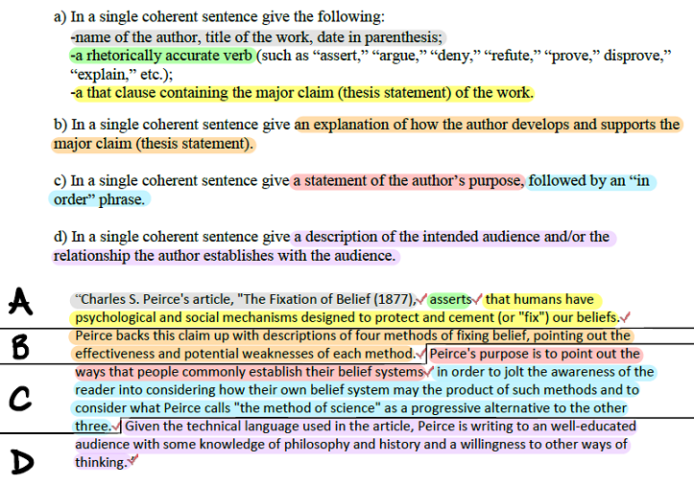
Putting all together.

Slide 28
Example for1(author, genre and title of work, date, an accurate content verb. THAT clause, main idea. WHO+WHAT). Notice the who and what is clearly defined in the first précis sentence.
Philipa Gregory’s novel, The Other Boleyn Girl (2001), implies that ambition possesses the power to corrupt and dispense true gratification, filling the heart solely with desire infused with greed and the ravenous hunger to reign.

Slide 29
Example of part 2 (synopses of each or grouped paragraphs)
Gregory develops this assertion through vivid description of life in the Tudor court and examination of cut-throat antics of a ruthless family-members of whom will execute to attain absolute power.
Example for Sentence part 3 (author’s apparent purpose, followed by an “in order to” phrase).
Gregory’s purpose of elaborating on ambition is to depict the outlandish lengths one will embark in order to fill a selfish void within one’s greedy and desperate soul.

Slide 30
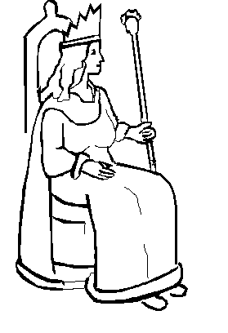
Example for part 4 (intended audience and/or the relationship)
Gregory engages the average woman through the themes of scandal, conniving competition, and passionate lust, all of which evokes every woman’s desire to be a queen.

Slide 31
Summary/Precise, polishing.
Finally, double-check to make sure that your summary contains no
–Inadvertent plagiarism
–Thoughts or analysis of your own
–Spelling or grammatical errors

Slide 32
Tips
Make it clear to the reader that you are reporting somebody else’s views, not your own, which means you will have to make use of reporting structures. repotted speech.
According to Ms. Green, …
Ms. Green pointed out // said // added // told the interviewer that …
Ms. Green went on to say that …
2. Find the use of the Passive Voice necessary.
It was said that …
The point was made that …
A different point of view was expressed by …

Slide 33
Tips
3. Existential constructions are also useful in this genre:
There was no unanimity about …, The panel could not reach a decision on …,
The mind of the meeting was …
4. Follow the conventions of Indirect Speech. Use transformation from Direct to Reported.
a) The predominant verb tense will be the Simple Past, e.g. am doing=> was doing
The so-called historical present is not used in English, except with universal truths, e.g.
b) You will have to adapt spatial references, e.g. here there
c) You will have to adapt temporal references, e.g. yesterday the day before
d) You will have to adapt number, e.g. you he // she // they

Slide 34
5. Use the following three kinds of sentences:
a) Statements: here you need to follow the reporting verb with “that”, but it is optional:
Ex: said to, told, informed, boasted, commented, remarked, mentioned to the meeting, etc.
b) Questions: here you need to follow the reporting verb with “if” or “whether”. Remember
not to write any question marks:
Ex: asked, wanted to know, enquired, wondered, was curious to know, requested, begged, etc.
c) Orders: here you need to follow the reporting verb with “to + infinitive”. Remember not to write any exclamation marks:
Ex: to order, to command, to tell, to request, to urge, to pleads, shouted to, etc.

Slide 35
Tips
6. Make your summary`s structure clear and help reader to understand the logic of your text or the sequence of events.
Use cohesive devices/semantic markers, conjunctions, link-words.

Slide 36
TASK: Read the text given and step by step follow the given instruction.

Slide 37
Putting all together.

